Slide 1
UVS Team 1

Slide 2
Path Planning
Path-planning requires a map of the environment
Platform to be aware of its location with respect to the map.
Grid maps requires large memory
Large Computational time to traverse data structures with large numbers of vertices
The distance between two points in a grid based on a strictly horizontal and/or vertical path
Opposed to the diagonal distance

Slide 3
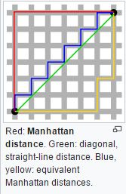
Path Planner Navigation Function-Manhattan Distance
Division of space into regular grid
Mark cells that contain obstacle
Free cells are used for path
Starting from goal distance increases 4 connected neighborhood
Increases till the current location.
Back trace the path until it reach goal

Slide 4
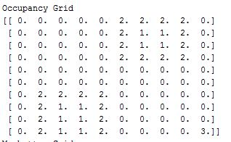
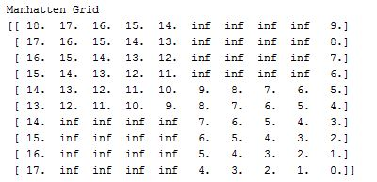
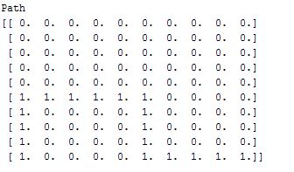

Program Results

Slide 5
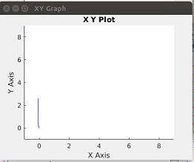
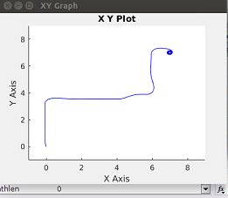
Simulation Results

Slide 6
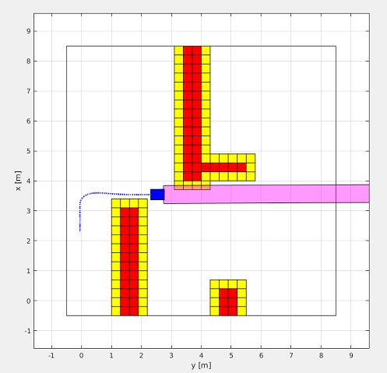
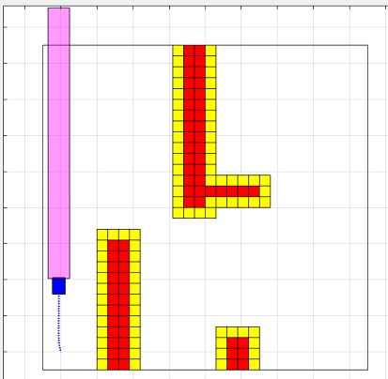
Results

Slide 7
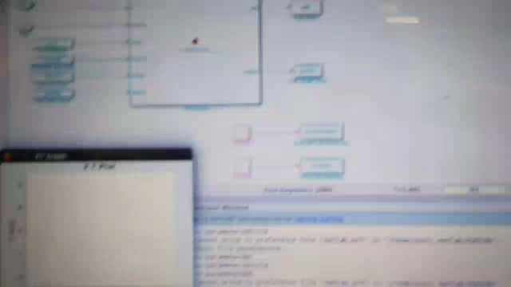
Result videos

Slide 8
Thank YOU !

